Slide 1
IBM University Engagement Project Submission
“Exploring the Power of Agentic AI with IBM Granite and LangFlow”

Slide 2

Project Tile – [Smart Research Assistant]
Domain of Project – [Education & Research.]
Student Name | Recent Passport Photo | Email ID | Mobile number [WhatsApp]
MOHAN RAAJ C |  | cmohanraajcse13@gmail.com | 9345294066

Slide 3
Problem Statement -
Problem Statement: Research Agent
The Challenge
Research and innovation require analyzing vast amounts of academic information, but finding, reviewing, and organizing relevant research is often time-consuming and complex. Research data is scattered across multiple sources, making efficient knowledge discovery and insight generation challenging.
The Objective
Build an AI-powered Research Agent that delivers intelligent research assistance and knowledge discovery for students, researchers, academicians, and industry professionals. The solution should:
Literature Search & Retrieval
Automatically search and retrieve relevant research papers, articles, and academic resources from trusted repositories.
Research Paper Summarisation
Generate concise summaries of research papers, highlighting key findings, methodologies, and conclusions.
Knowledge Retrieval using RAG
Fetch and synthesise relevant information from stored research documents and external academic sources using Retrieval-Augmented Generation (RAG).
Research Assistance & Insights
Provide explanations, answer research-related queries, identify trends, and suggest future research directions.
Multi-Agent System
Research Knowledge Agent – Retrieves research papers and relevant academic information.
Literature Review Agent – Summarises papers and extracts key findings.
Research Advisory Agent – Suggests research directions, identifies gaps, and provides recommendations.
Report Generation Agent – Generates structured research summaries, reports, and documentation.

Slide 4
Technology Used
Tech Stack (Mandatory)
Use any one of the following approaches:
LangFlow + IBM watsonx.ai + Granite Models
IBM Cloud Agentic Lab with IBM Granite Models
Replicate with LangChain + RAG + IBM Granite Models
I used LangFlow + IBM watsonx.ai + Granite Models

Slide 5
Proposed Solution -
Proposed Solution:
AI-Powered Research Agent
The proposed solution is a multi-agent AI-powered Research Agent built using LangFlow, IBM watsonx.ai, IBM Granite Models, ChromaDB, and Retrieval-Augmented Generation (RAG) to assist researchers, students, academicians, and industry professionals in conducting efficient and intelligent research.
At its core, the solution uses a RAG pipeline to retrieve relevant research information from trusted academic sources such as arXiv papers, journals, and stored knowledge repositories. The retrieved content is embedded and stored in a ChromaDB vector database, enabling semantic search and contextual retrieval of research information using IBM Granite models.
The system consists of four key agents:
Research Knowledge Agent retrieves and summarizes relevant research papers, articles, and academic resources using RAG.
Literature Review Agent analyzes multiple research papers and generates concise literature reviews, key findings, and research trends.
Research Advisory Agent identifies research gaps, suggests future research directions, and provides recommendations based on retrieved knowledge.
Report Generation Agent creates structured research summaries, reports, and draft documentation from collected research information.
The solution includes a user-friendly interface built using LangFlow, allowing users to submit research queries and receive accurate, evidence-based responses in real time.
Lang Flow is used to orchestrate agent workflows, while IBM watsonx.ai ensures scalable model deployment and AI governance.
IBM Granite Models power reasoning, summarization, information extraction, and intelligent response generation.
Overall, this solution delivers an end-to-end intelligent research assistant that automates literature search, paper summarization, knowledge discovery, and report generation, thereby improving research productivity, accuracy, and innovation.

Slide 6
Langflow component Used -
Chat Input – Accepts research queries and user requests from the interface.
2) IBM watsonx.ai Model – Uses IBM Granite models to process research queries, perform reasoning, and generate intelligent responses.
3) Agent Component – Acts as the central Research Agent, coordinating tools, retrieving information, and generating research insights.
4) ChromaDB – Stores vector embeddings of research documents and enables semantic search through RAG-based retrieval.
5) arXiv Tool – Searches and retrieves relevant academic papers and scientific publications from the arXiv repository.
6) Chat Output – Displays generated summaries, research findings, recommendations, and final responses to the user.

Slide 7
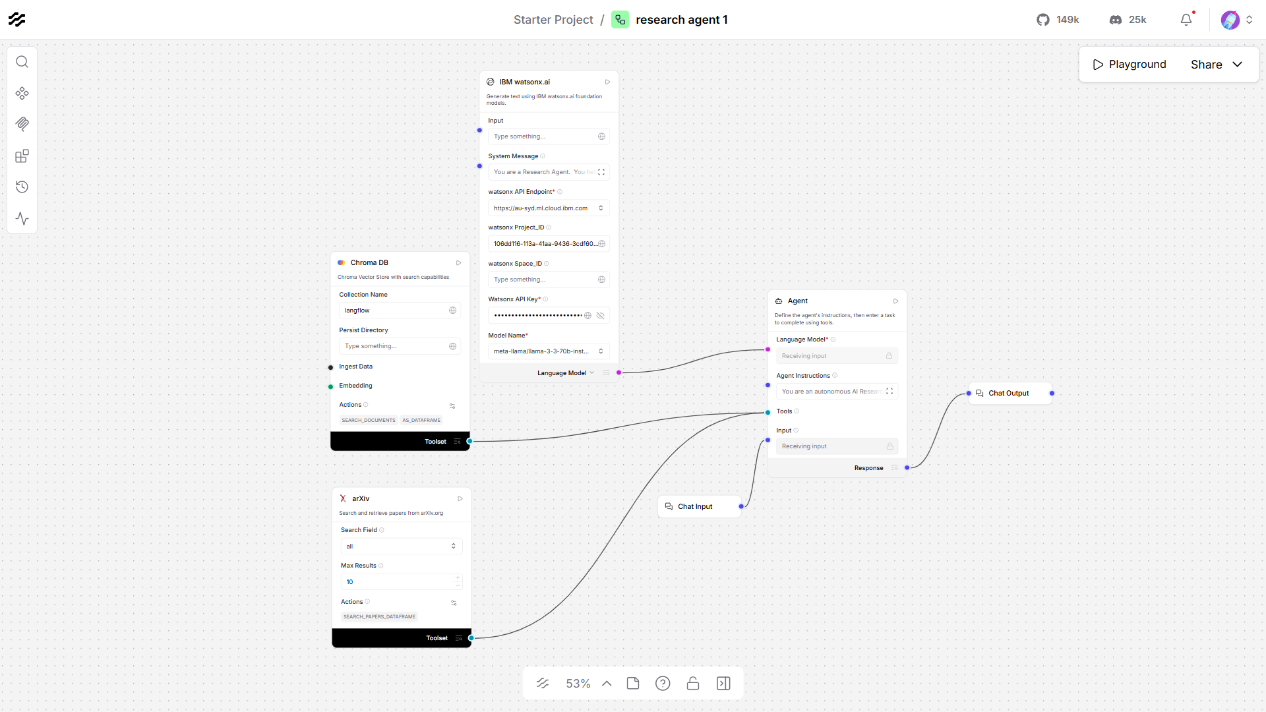
Langflow workflow -

Slide 8
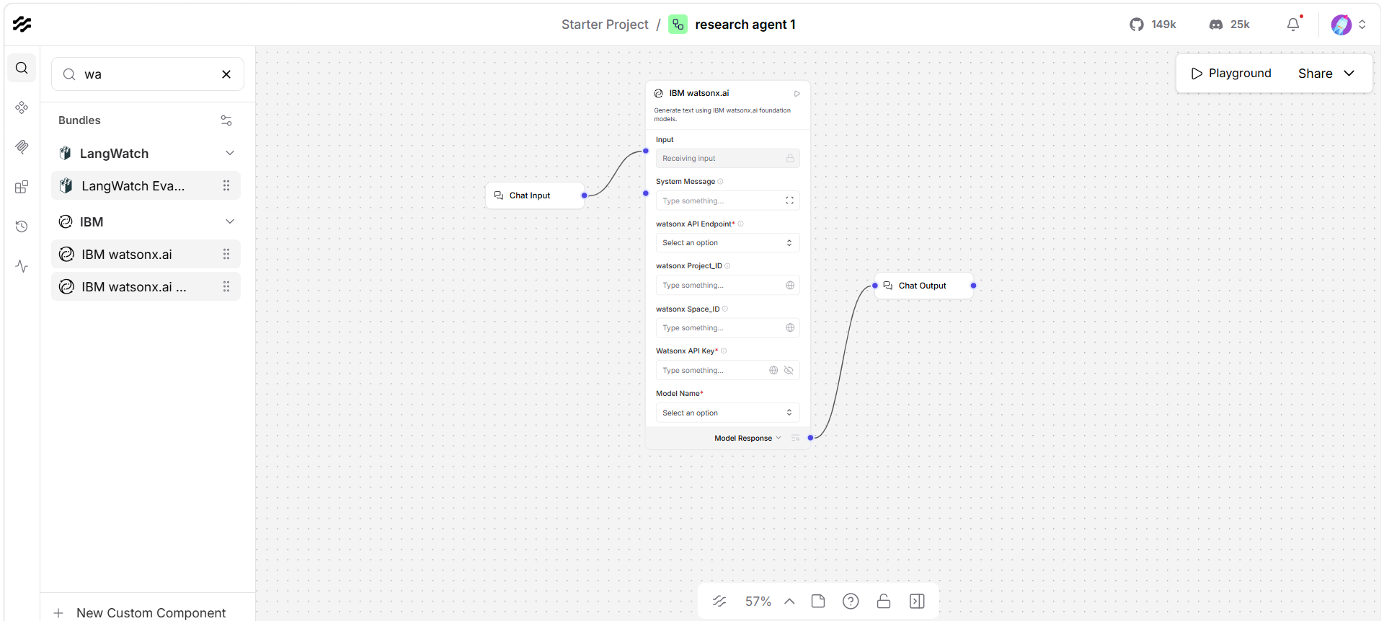
Langflow workflow -

Slide 9
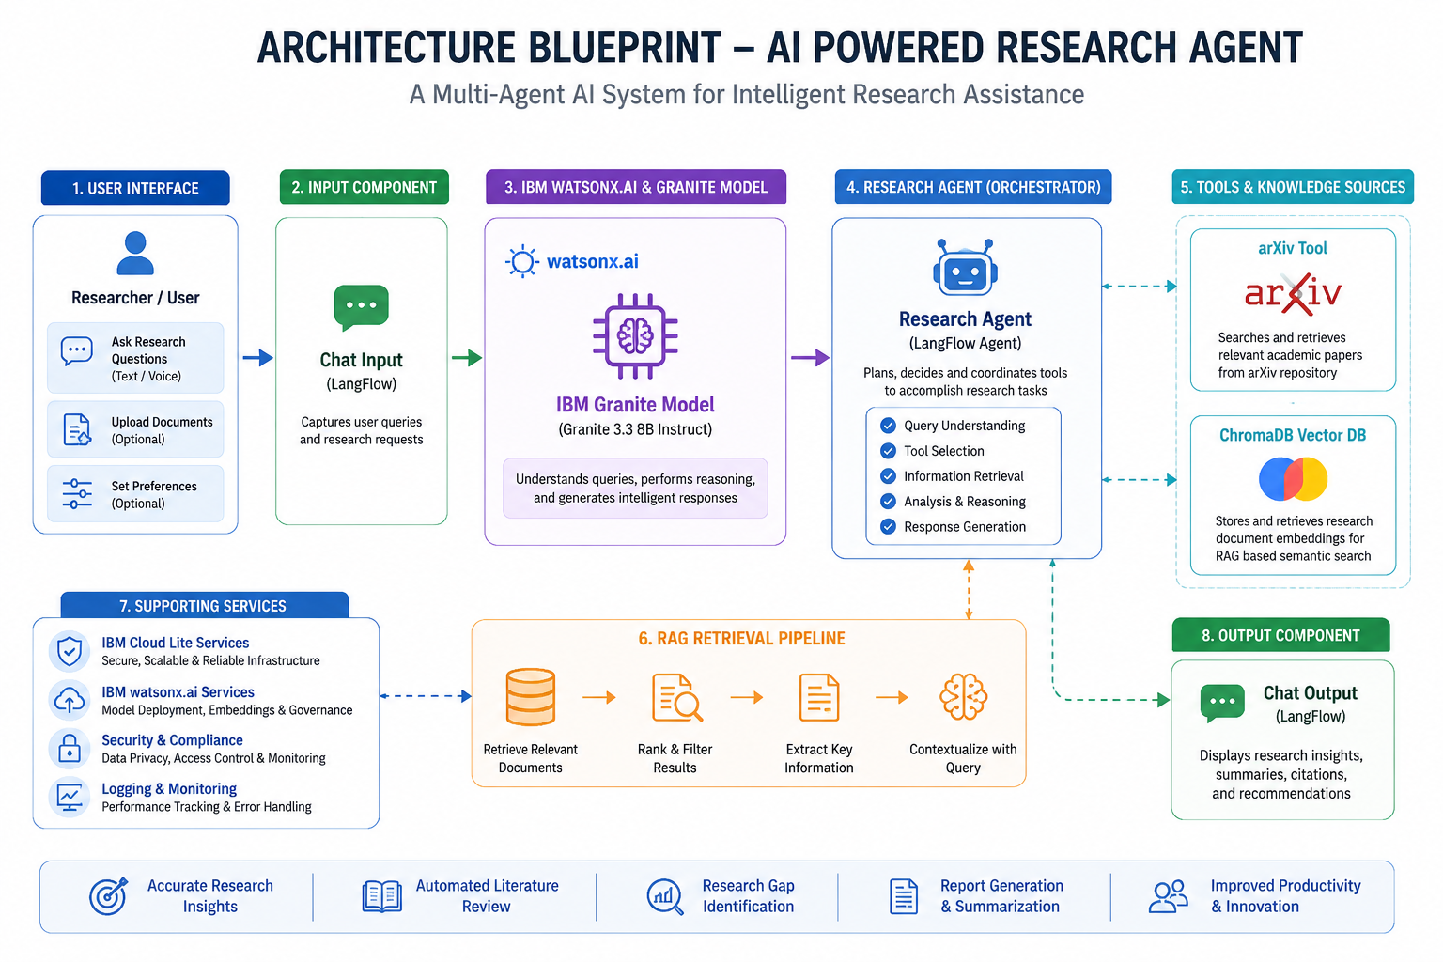
Architecture blueprint

Slide 10

Role of Agentic AI in the solution
Role of Agentic AI in Research Agent
Agentic AI enables the Research Agent to function as an intelligent, autonomous research assistant rather than a simple search tool. Using IBM watsonx.ai and IBM Granite Models, it coordinates multiple components to perform research-related tasks efficiently.
Each component performs a specialized role—such as retrieving research papers, conducting semantic searches, summarizing academic content, and generating research insights—while working together to deliver accurate and context-aware responses. This collaborative approach improves research quality and reduces manual effort.
Agentic AI also provides context awareness by understanding the user's research objectives and queries. It can retrieve relevant information from academic sources, analyze findings, and generate meaningful summaries and recommendations.
Additionally, the system continuously adapts to user inputs and combines information from multiple sources, enabling better decision-making and knowledge discovery.
Overall, Agentic AI makes the Research Agent proactive, intelligent, and goal-driven, acting as a smart digital research assistant that accelerates literature review, knowledge retrieval, and research innovation.

Slide 11
Technology Used
LangFlow Platform – Used for designing and orchestrating the Research Agent workflow visually through interconnected AI components and tools.
IBM Granite Model (Granite 3.3 8B Instruct) – Used for natural language understanding, reasoning, research paper summarization, and intelligent response generation.
IBM Cloud Lite Services – Provides a secure, scalable, and reliable cloud environment for building, deploying, and managing the Research Agent.
RAG (Retrieval-Augmented Generation) – Retrieves relevant research information from academic sources before generating responses, improving accuracy and reducing hallucinations.
IBM watsonx.ai – Used for model deployment, inference, AI governance, and integration of IBM Granite Models.
ChromaDB Vector Database – Stores research document embeddings and enables semantic search and RAG-based knowledge retrieval.
arXiv API – Retrieves academic papers and scientific publications for literature review and research assistance.

Slide 12
Novelty and Uniqueness
The proposed Research Agent stands out by combining Agentic AI, Retrieval-Augmented Generation (RAG), and academic research automation into a single intelligent system.
Multi-Agent Intelligence – Multiple specialized components collaborate to perform research-related tasks efficiently.
RAG-Based Knowledge Retrieval – Retrieves relevant research information before generating responses, improving accuracy and reliability.
Automated Literature Review – Summarizes research papers and extracts key findings automatically.
Academic Paper Discovery – Integrates arXiv to search and retrieve relevant scientific publications.
Semantic Search Capability – Uses ChromaDB for context-aware retrieval of research information.
Research Insight Generation – Assists in identifying trends, research gaps, and future directions.
Scalable & Enterprise Ready – Built on IBM watsonx.ai and IBM Granite Models for reliability and governance.
This makes the solution an intelligent digital research assistant rather than a traditional search system.

Slide 13
Git Hub Link
Please create public github repository (Enable Add README button while creating repository) with format –
Please test and Paste the working Github URL –https://github.com/CMohanRaaj/Smart-Research-Assistant.git
Make sure you have Uploaded following three files into your github repository 1) app.json file , 2) yourproblemstatement.pdf file 3) your projectpresntation.pptx file 4)any other files
·
·
·

Slide 14
Future Scope
1. Integration with Multiple Research Databases
The system can be extended to connect with IEEE Xplore, Springer, ScienceDirect, PubMed, and Google Scholar, enabling access to a broader range of academic resource
2. Automated Citation and Reference Management
The agent can automatically generate citations in APA, MLA, IEEE, and Harvard formats, reducing manual effort and improving research documentation.
3. Research Gap Identification
Advanced AI capabilities can analyze existing literature and identify unexplored research areas and opportunities.
4. Research Report Generation
The system can generate complete literature reviews, technical reports, and research documentation automatically.
5. Collaborative Research Platform
Future versions can support team-based research, allowing multiple users to share findings and collaborate in real time.
·
·
·

Slide 15


